Slide 1

Structure

Slide 2
Oral Citations
If you use it, cite it
Cite early, refer to author until next citation
Not full citation*
Author
Name of article, study, paper, research
When
(+) established credibility
Where: Journal, institution, blog

Slide 3
For Example
“…According to Nate Bowling’s 2014 article, Big Data and The Rhetorical Narrative…
“…this is exactly what Dr. Susan Thompson explores in their 2021 article Morning Speech Classes are really Dumb.”
“Jeff Diamant, a Pew Research Center, Senior Researcher and Analyst, concluded in his essay Faith on the Hill: The Religious Composition of the 118th Congress…”

Slide 4
Claim – Evidence
INTRO –
MAIN POINT 1:
FIRST ARTICLE/SOURCE
SUMMARY OF THAT ONE PIECE OF INFORMATION
MAIN POINT 2
SECOND ARTICLE/RESOURCE
SUMMARY OF THAT ONE PIECE OF NEW INFORMATION
Have you ever considered that we shouldn’t be taking speech classes first thing in the morning.
….
“…this is exactly what Dr. Susan Thompson explores in their 2021 article Morning Speech Classes are really Dumb.”
….
CLAIM ABOUT MAIN POINT
EVIDENCE TO SUPPORT CLAIM
IMPORTANCE OF CLAIM TO THESIS

Slide 5
Building a Speech
Thesis
Body
Transitions
Introduction
Conclusion

Slide 6
Thesis
Topic and Purpose
“Road Map”
Stands Alone
Simple and Calculated

Slide 7
BIG NOTE OF WARNING
End Goal vs. Thesis
Yes, the End Goal can still be the Thesis statement
If you see your ideas*

Slide 8
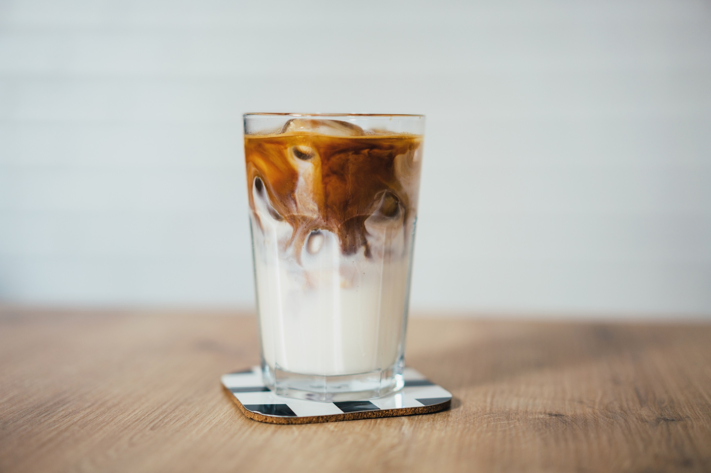

Topic and Purpose
What is it? (Topic)
What about the topic should the audience be considering? (Purpose)
-Comfort food
-Taste of Home
-Save money -Secret to the Starbucks Flavor

Slide 9

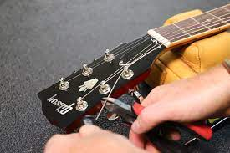
“Road Map”
Create a Repetitive Check List
Indicate Direction
How to pick out new strings,
How to re-string the guitar,
And finally tune the new strings.
What origami is,
How to fold an origami crane,
Where you can find instructions for other origami animals.

Slide 10
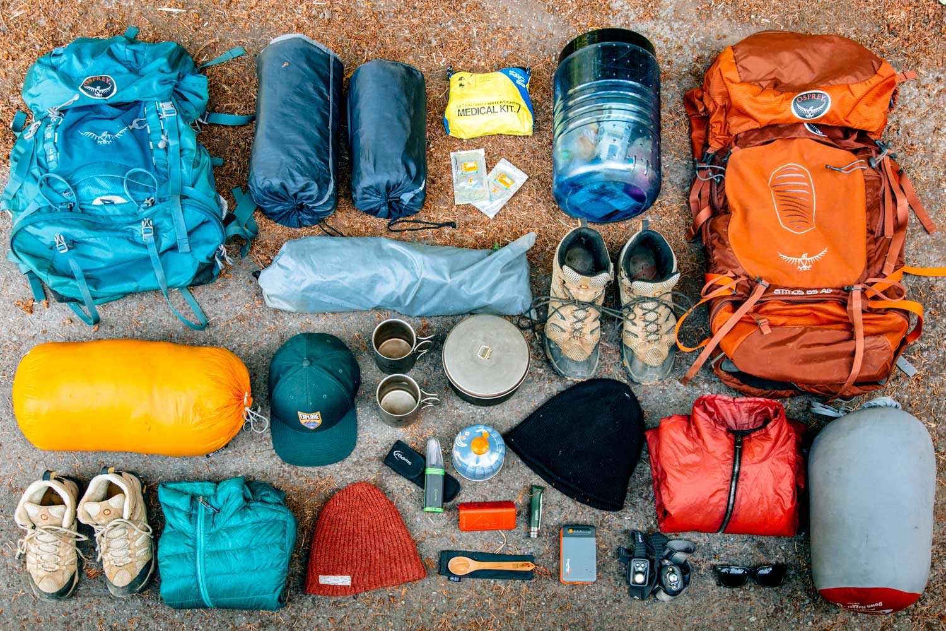

Stands Alone
Mechanical
Use Precise language
Why you should properly plan for a backpacking trip,
Explain the gear you should carry in your backpack,
And lastly, how you can find good backpacking gear without breaking the bank.

Slide 11
Simple
Today we will learn what we need to get started crocheting, next we will learn the basic steps for a single crochet stitch, last, I’ll lead you in the right direction towards your first crocheting project.
Today I’m going to teach you how to properly shine your shoes. (Good, Straight Forward, End Goal and Thesis)
Today we are going to discuss what a thesis statement is, how it functions, and define the steps you can take to replicate good thesis statements.

Slide 12
Don’t Copy Me…

Slide 13
The Basic idea of Power Points
Power Points do what?
Make Powerful Points

Slide 14
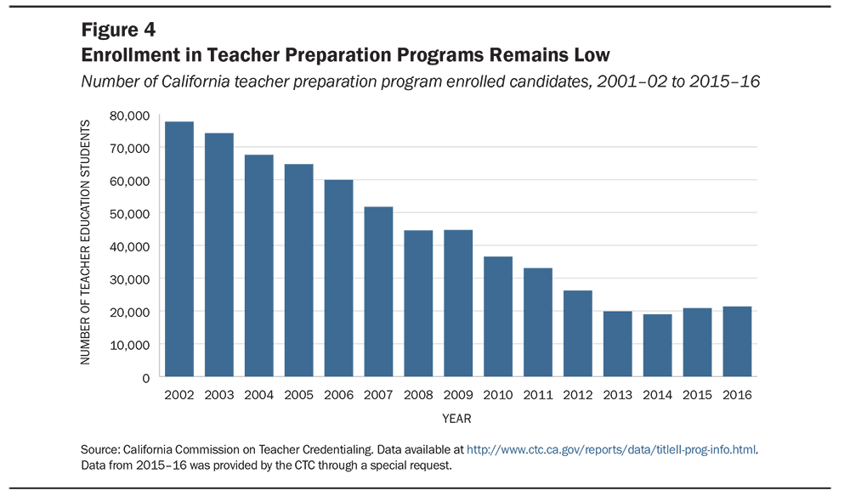
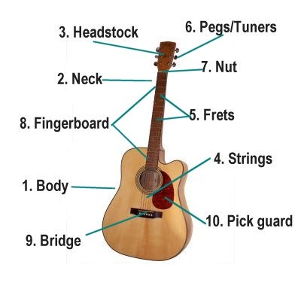
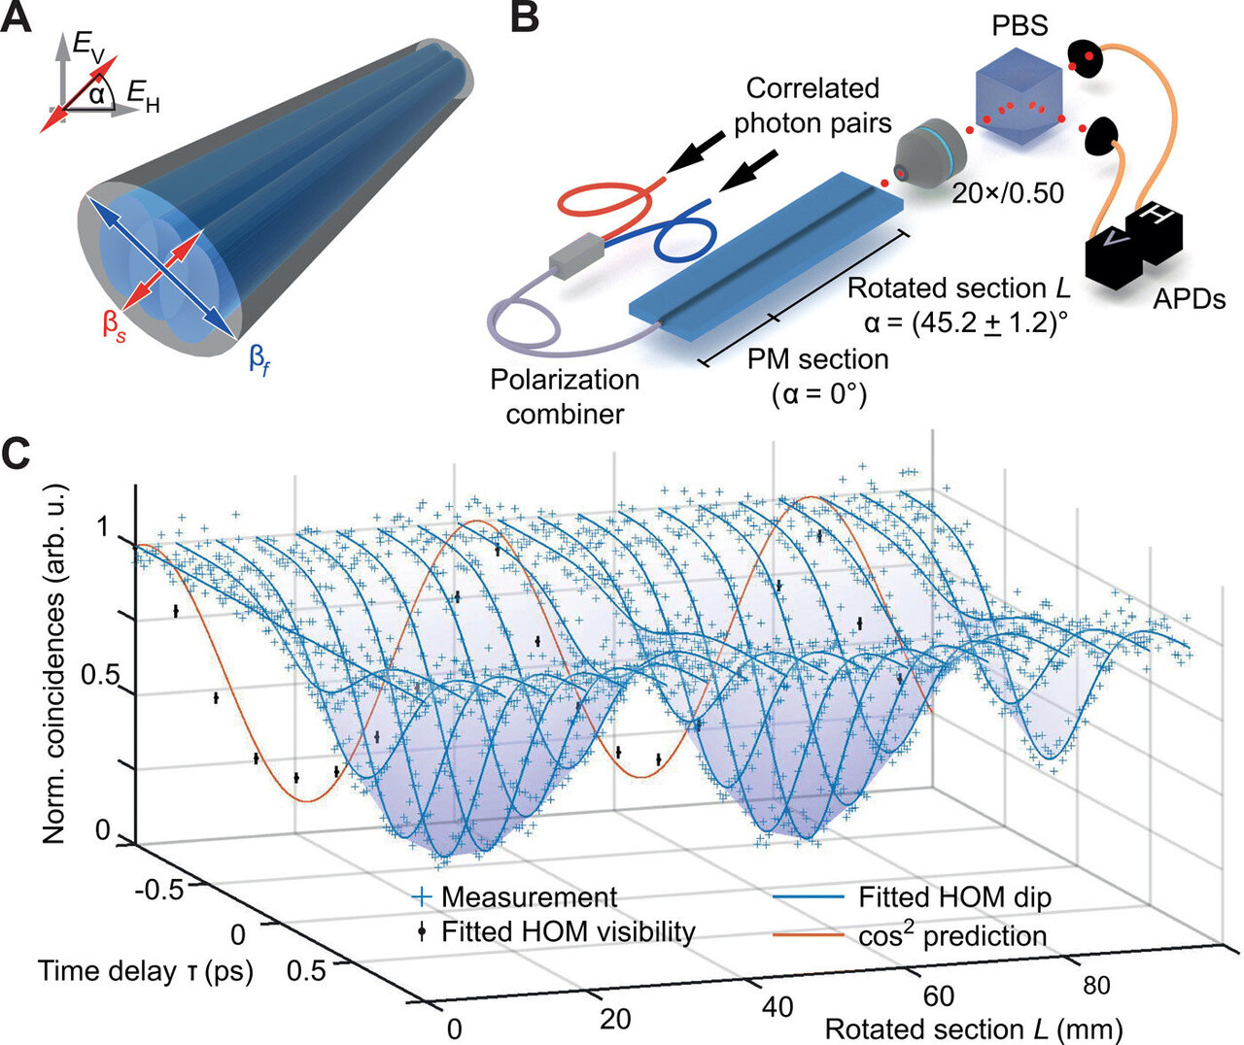
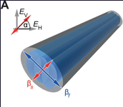

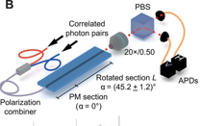
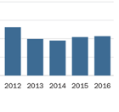
Considerations for Visuals, 6 Steps
Don’t divide your audience's attention
Simplify – One idea per slide*
Signaling – Highlighting Key Features
Divide when possible
Keep explanations close
Not Explaining your visuals

Slide 15
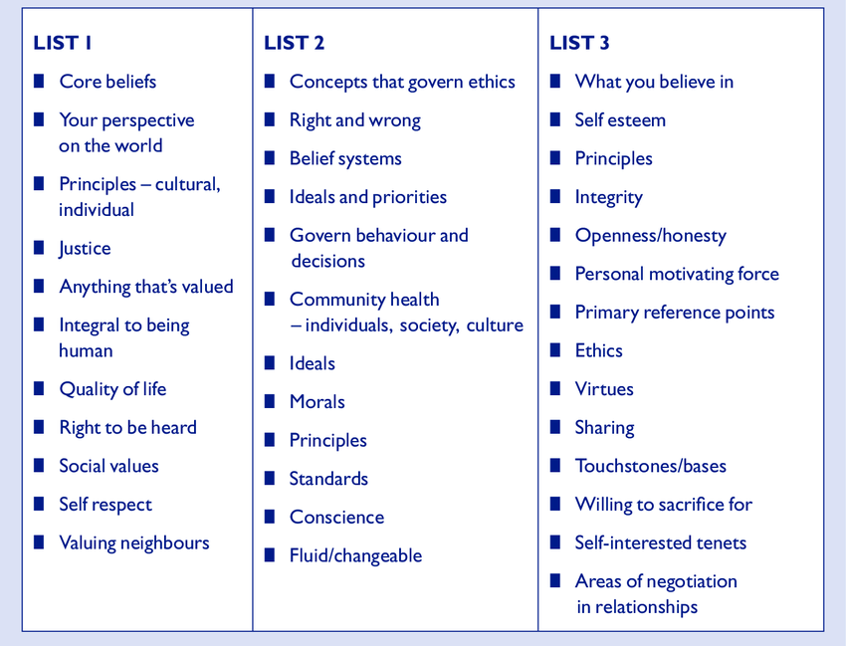
DO NOT COMPLICATE THE SLIDE
Bullet points put everyone to sleep…
Beware of Lists*
Headlines should be simple and direct
Use animations

Slide 16
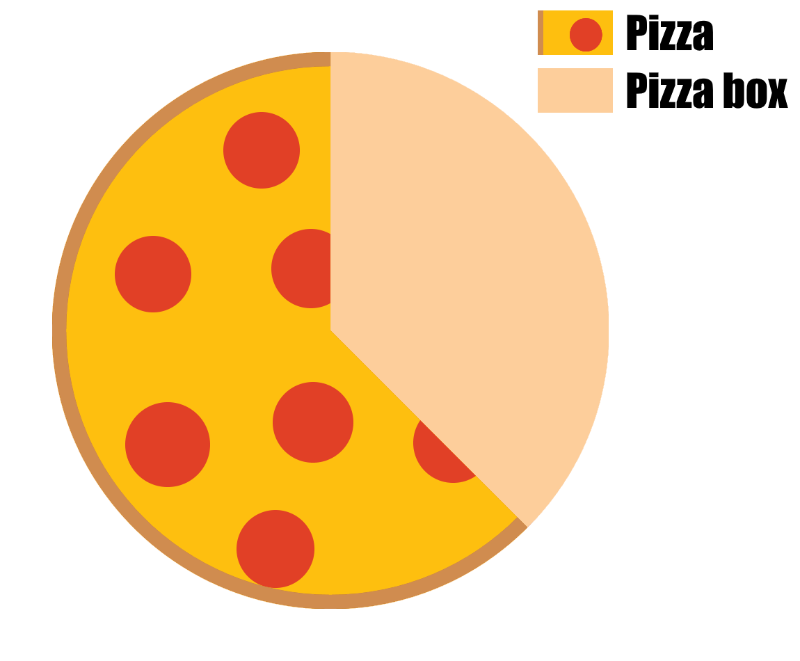
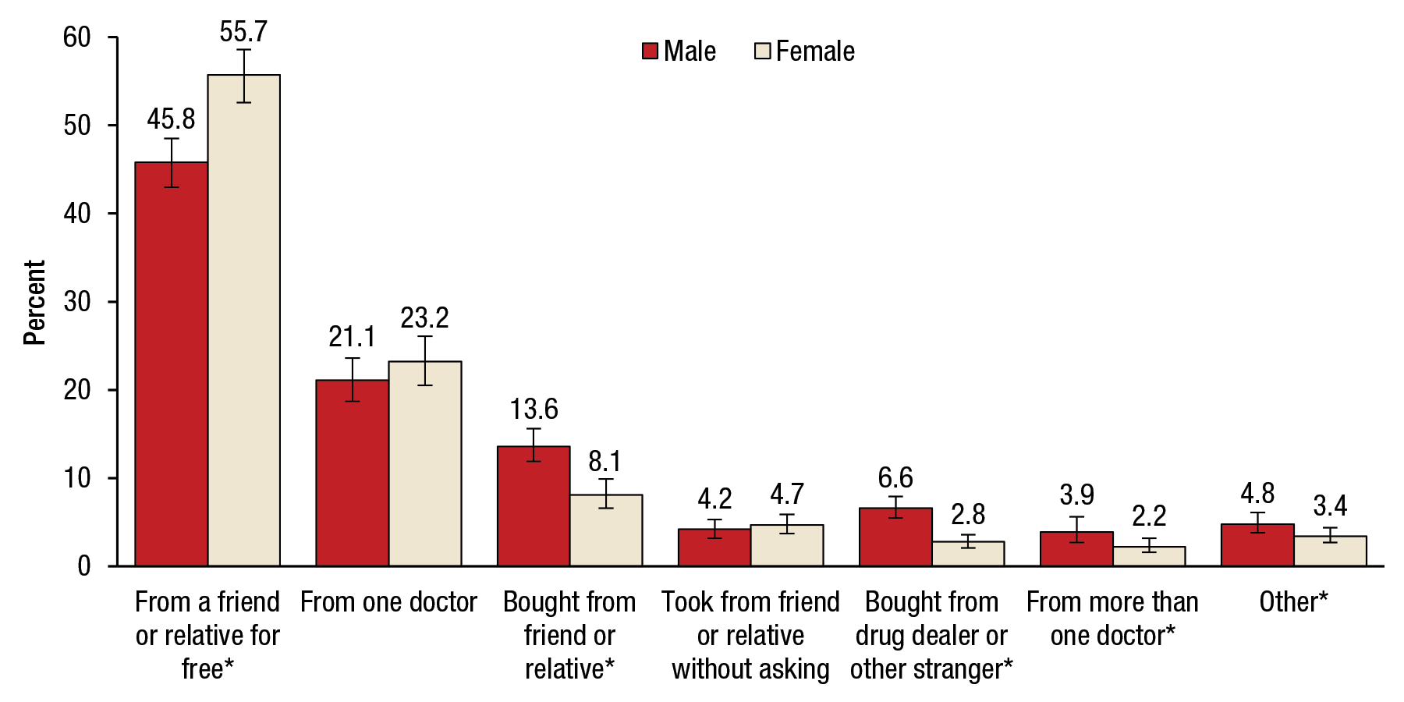
Visuals
Provide citation for your photos
Graphs should:
Be easy to understand
Identify the importance immediately
Be ethical
Nate Bowling, 2021, stolen directly off Google for the sake of this presentation. Probably created by some person on Reddit or IMGUR

Slide 17
Basics for presenting visuals
Visuals take longer to create than you think
Slow down when presenting images
Test all your technology
Check your ‘theme’
Time your slides

Slide 18
Structure

Slide 19
Starting from Scratch
Topic Selection
Determine the Goal
Inform, instruct, persuade
Audience and Time
Brainstorm
Can I talk about this topic without my notes?
What are the consequences of presenting the material poorly?
Does my topic divide the audience?
How much time do I need for context?

Slide 20
Building a Speech
Thesis
Body
Transitions
Introduction
Conclusion

Slide 21
Thesis
Topic and Purpose
“Road Map”
Stands Alone
Simple and Calculated

Slide 22
BIG NOTE OF WARNING
‘Considerations’
If you see your ideas*

Slide 23
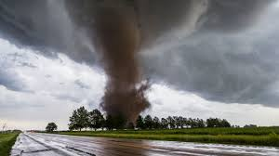
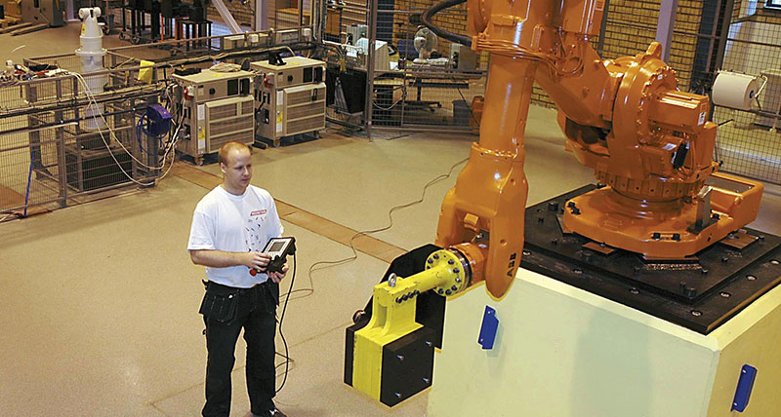
Topic and Purpose
What is it? (Topic)
What about the topic should the audience be considering? (Purpose)
Competition
Machine Learning
Economic Impact
Forecasting
Pressure Systems

Slide 24
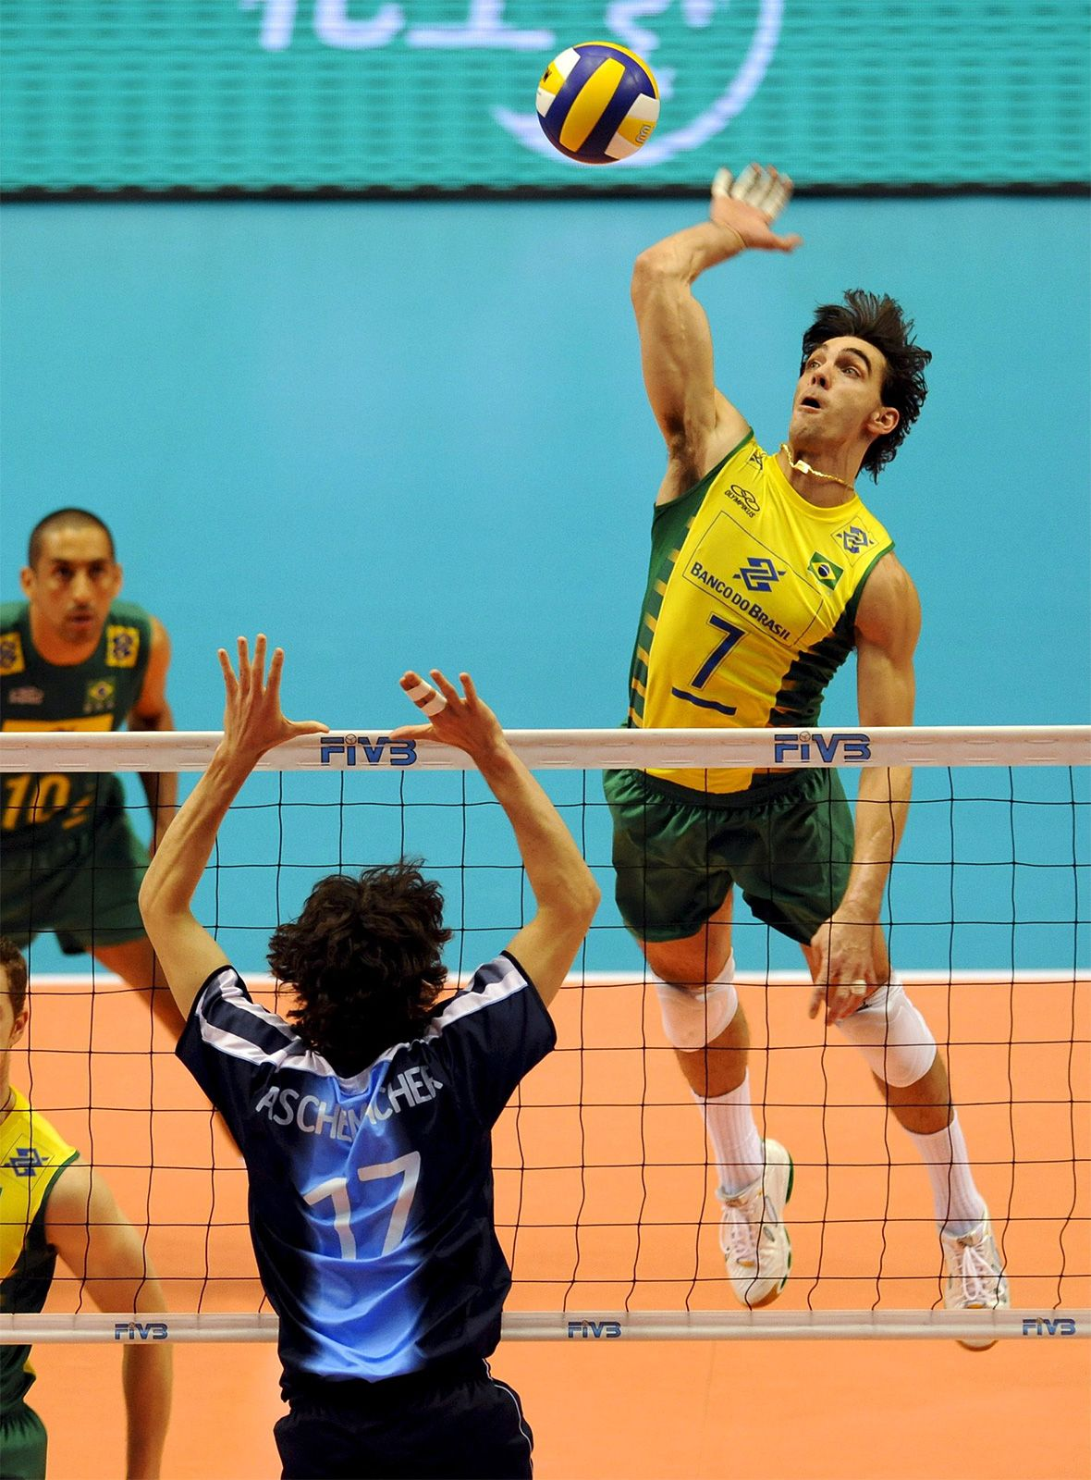

“Road Map”
Create a Repetitive Check List
Indicate Direction
Teach you the basic rules to volleyball
Then, we’ll examine volleyballs place in international competition
Lastly, what the future of volleyball looks like
Today we will explain what are ‘E-Sports’
Then, how E-Sports are currently funded
Lastly, the future of E-Sports and what’s next for its growth

Slide 25
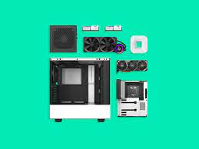
Stands Alone
Mechanical
Use Precise language
Why you should properly plan a build for your computer,
Explain the hardware you should use in your built computer,
And lastly, how you can find good computer hardware without breaking the bank.

Slide 26
Simple
Today I’m going to teach you about the major romantic attraction types, how those attraction types interact with one another, and how these attraction types can work best for you.
Today I’m going to teach you the key differences between EV and ICE engines, and what this means for you, a future car buyer
Today we are going to discuss what a thesis statement is, how it functions, and define the steps you can take to replicate good thesis statements.

Slide 27
Structure
Body and Transitions

Slide 28
Thesis
Topic and Purpose
“Road Map”
Stands Alone
Simple and Calculated

Slide 29
Body
Can your audience summarize your intended purpose?
Starting with your Main Points
Patterns
Continuous connection
Claim-Evidence Model

Slide 30

Starting with the Body
What’s the point?
Control over the message
Avoid forced sections

Slide 31
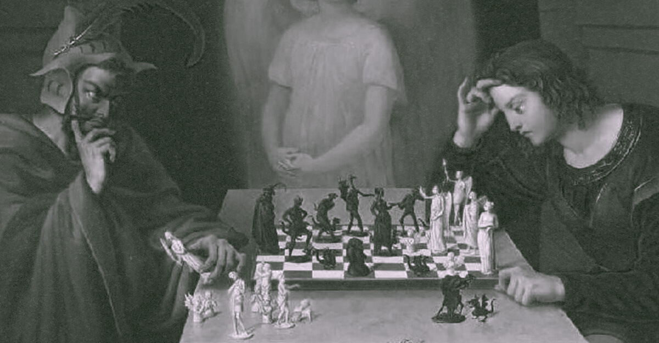
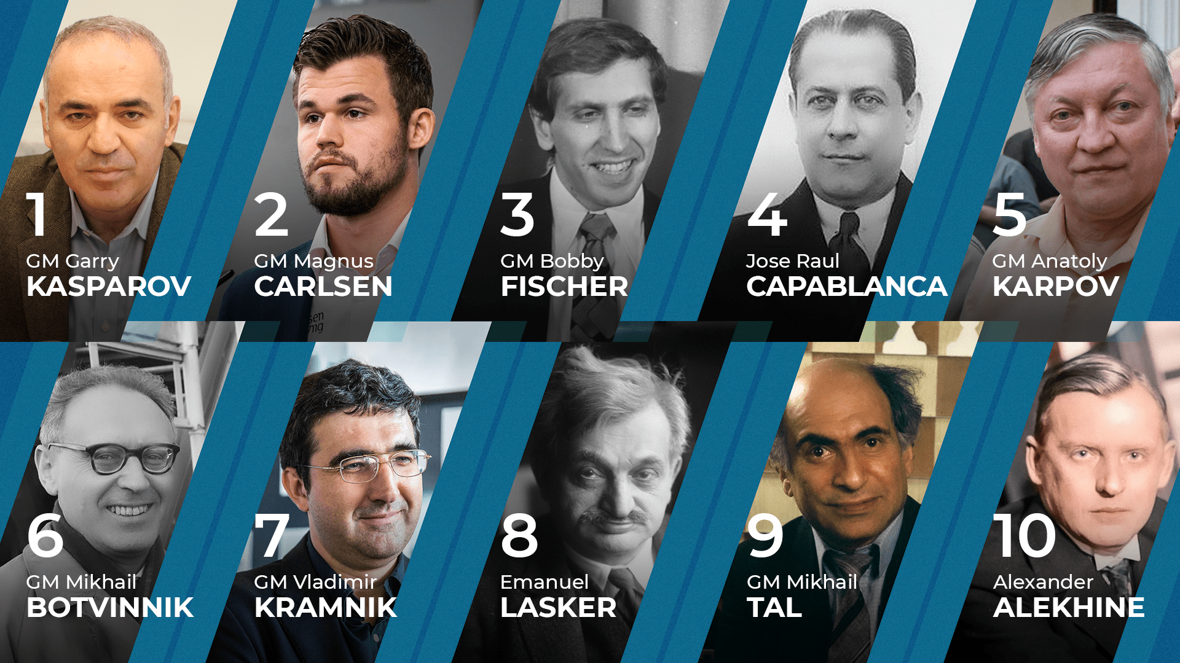
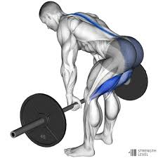
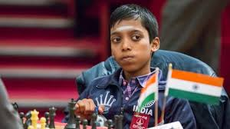
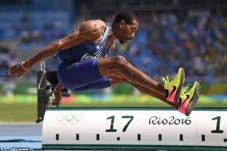
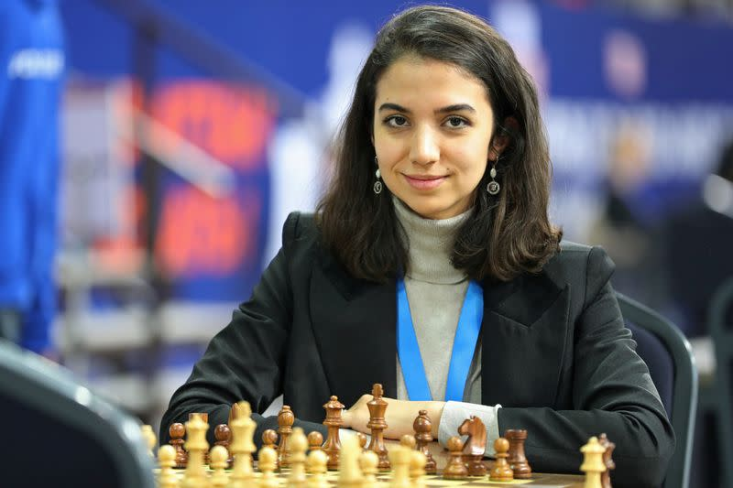
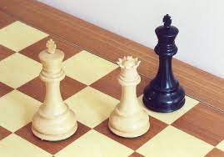
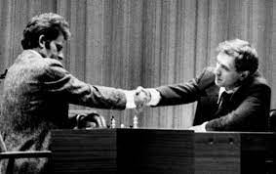

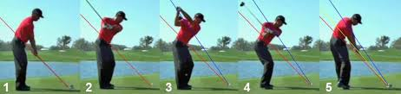
Patterns
Cheat Codes, Speech Costumes
Chronological
Spatial/Geographical
Topical
Cause-Effect
Problem-Solution (Persuasive)

Slide 32
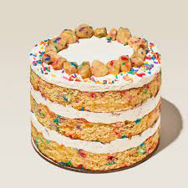
Continuous Connection
Raptor Space engine can get humans to Mars
Raptor Space engine is a new combustion cycle rocket
Space X is the worlds first private Space exploration company
Heavy-Lift Vehicles are the things of Science Fiction
The Mars Rover and replacement
Today we will look at what ‘Heavy-Lift Vehicles’ are, how the new Space X Raptor Engine works as a ‘Heavy-Lift Vehicle’, and what these vehicles mean for human space travel.
Should be easily connected
Consider the order
Use language from/for your Thesis
Rule of Three***

Slide 33
Closing vs. Conclusion
Have you completed your thesis?

Slide 34
Transitions
Separate and unique of its conjoined parts
Should include:
Acknowledgement of the Previous section
Foreshadow of the Future
Pause

Slide 35

Useful Transition Tips
Copy direction and language of thesis
Now - Impact
Because – How
Summary – Discussion
Today we will look at FIFA, what it is, it’s role in geopolitics and how World Cup hosts are selected.

Slide 36
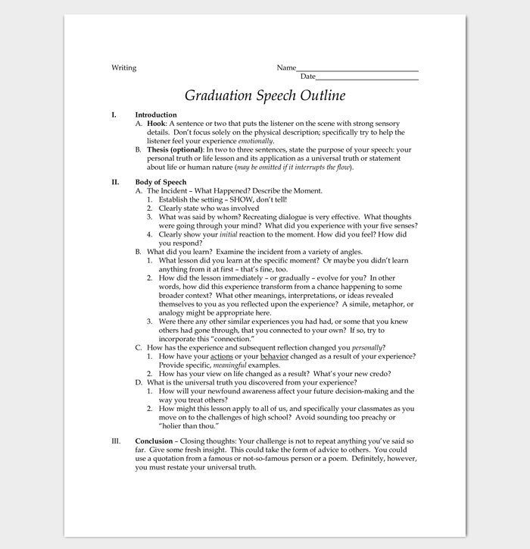
Useful Transition Tips
Should be written out

Slide 37
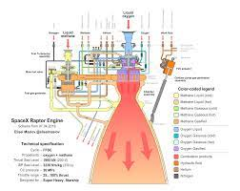
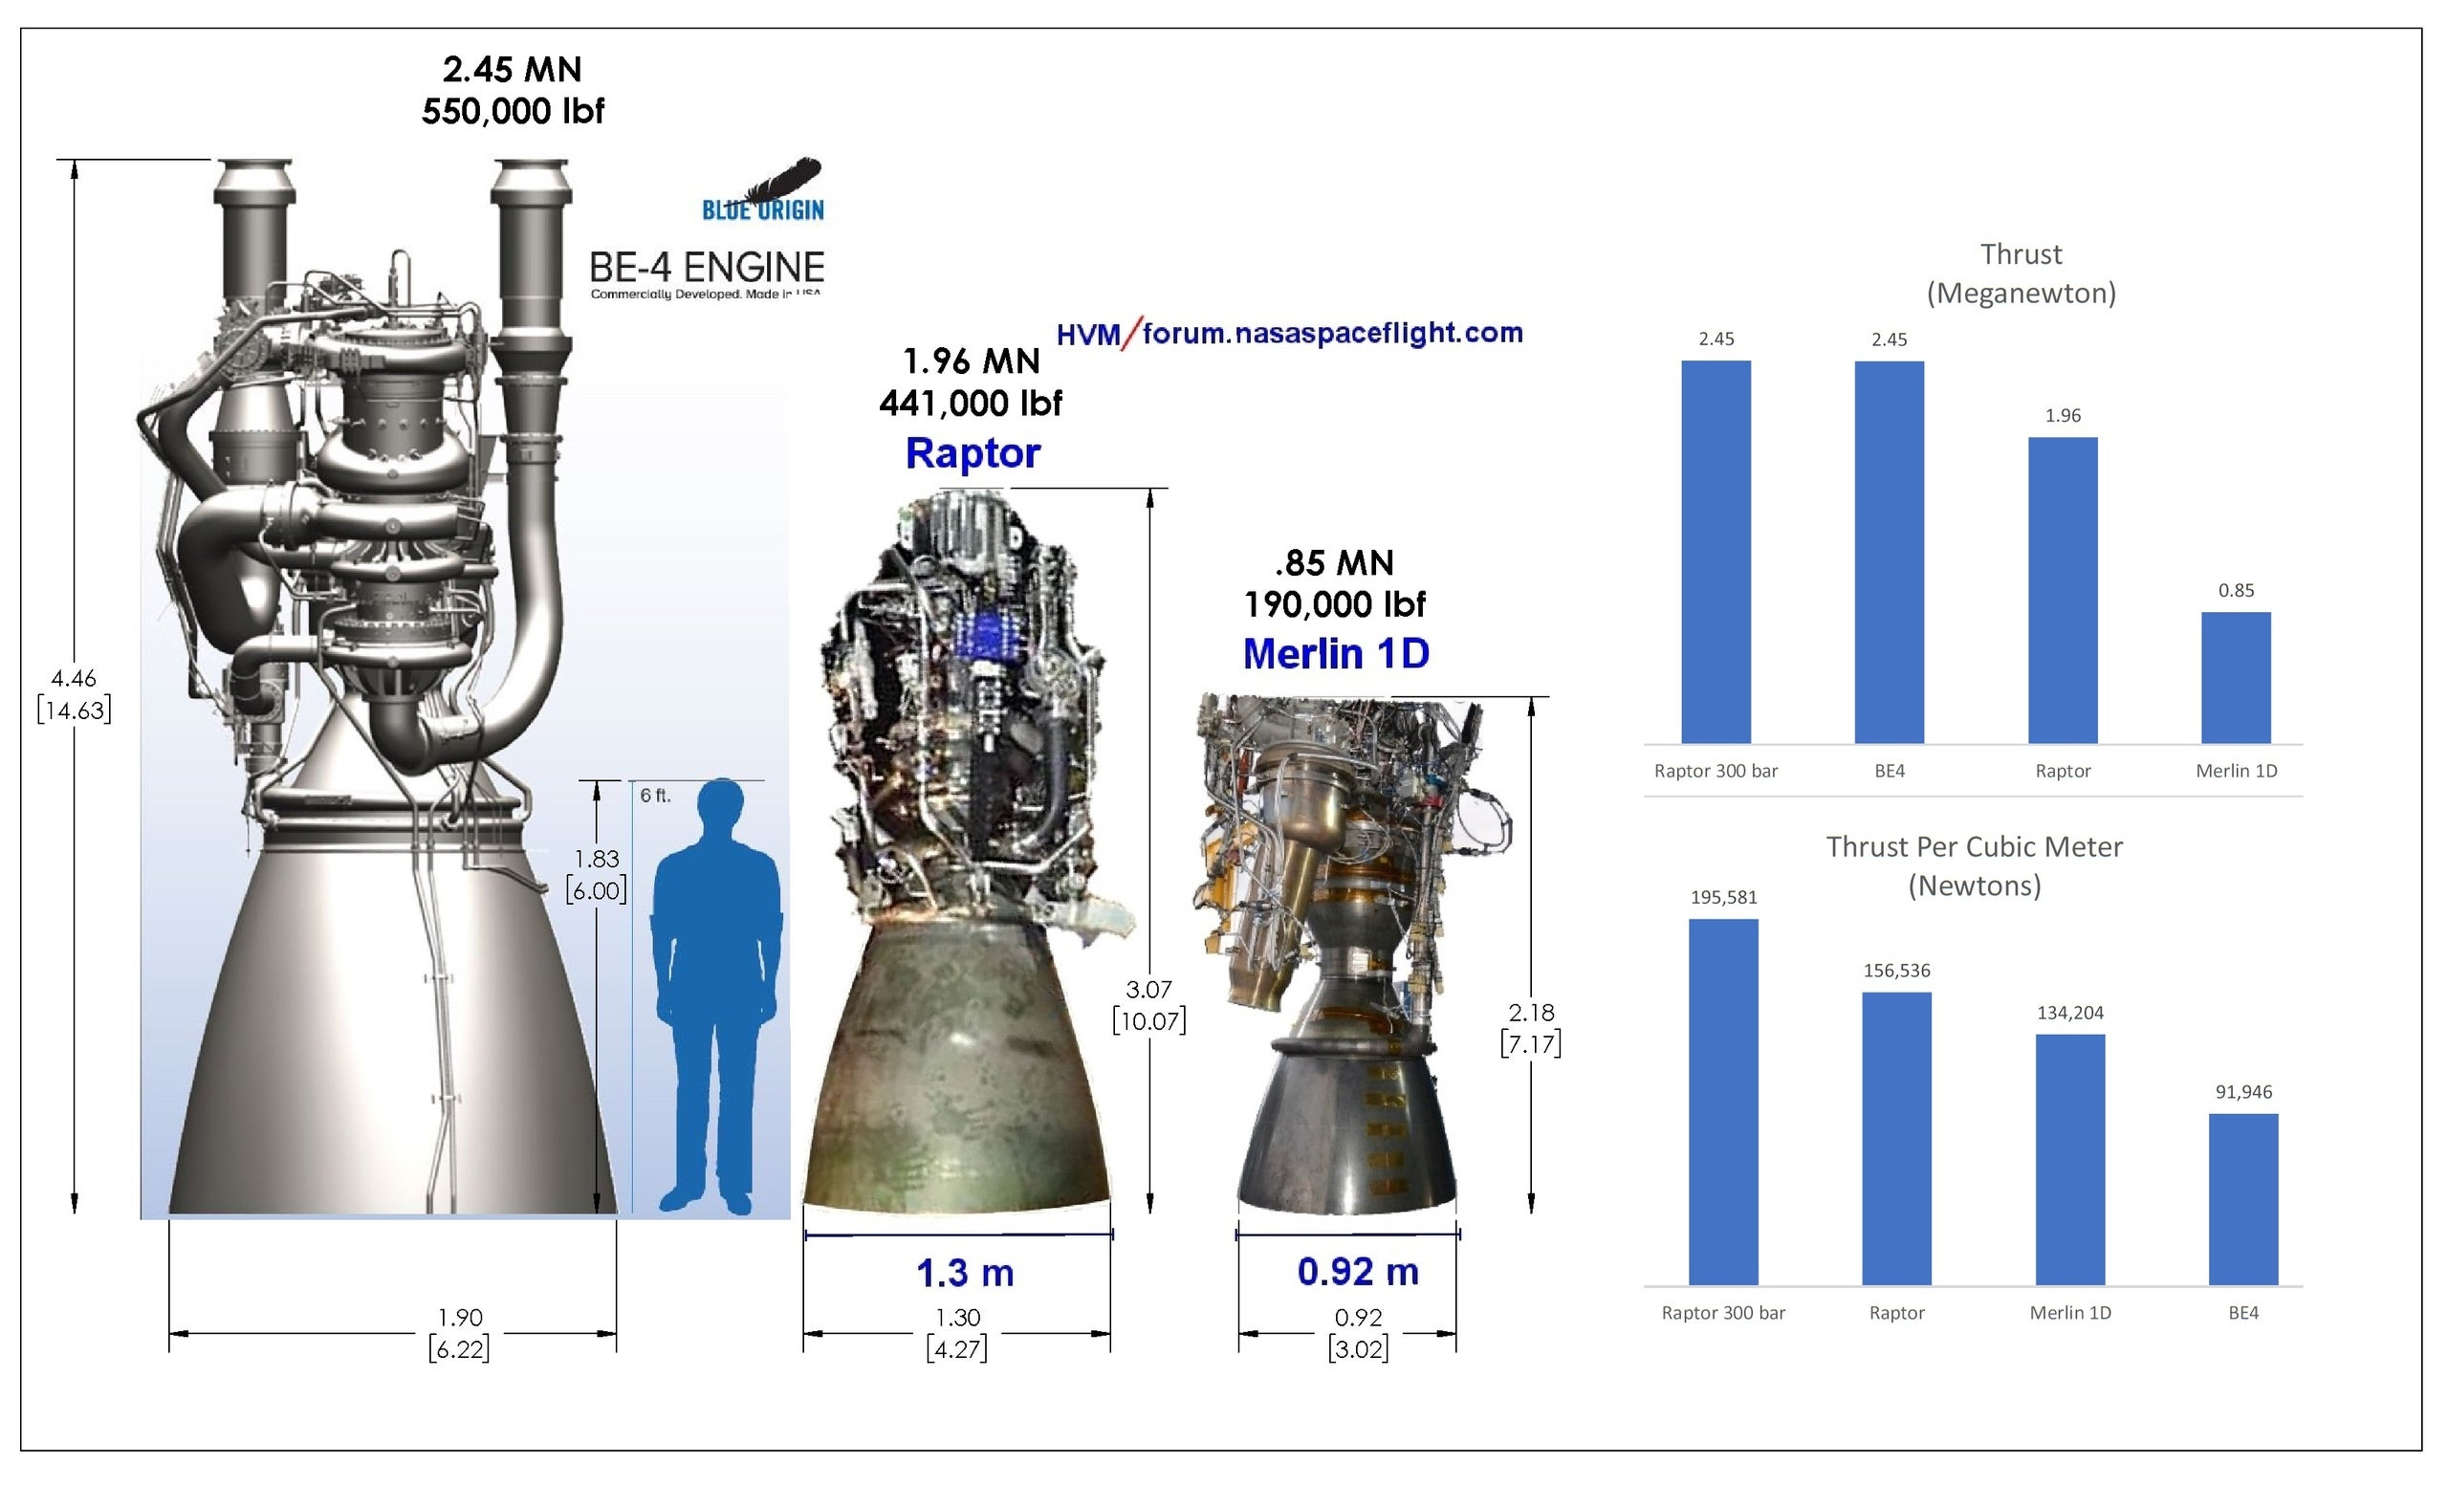
Useful Transition Tips
‘Crowding’ – What should the audience remember
“Considering the fuel necessary to propel Heavy-Lift vehicles, let’s now look at how the Raptor engine revolutionized their “Impossible” method.”

Slide 38
Structure
Introduction and Conclusion

Slide 39
Body and Transitions
Patterns
Transitions should:
Previous
Future
Pause
Transition Tips
Use Thesis Language
Written out fully
Correct any Crowding

Slide 40
“Getting the audiences attention”
“Unique Connection”
Get to the point
Funnel Content
Establishing flow

Slide 41

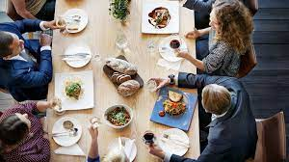
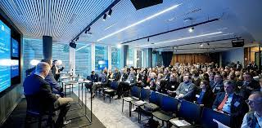
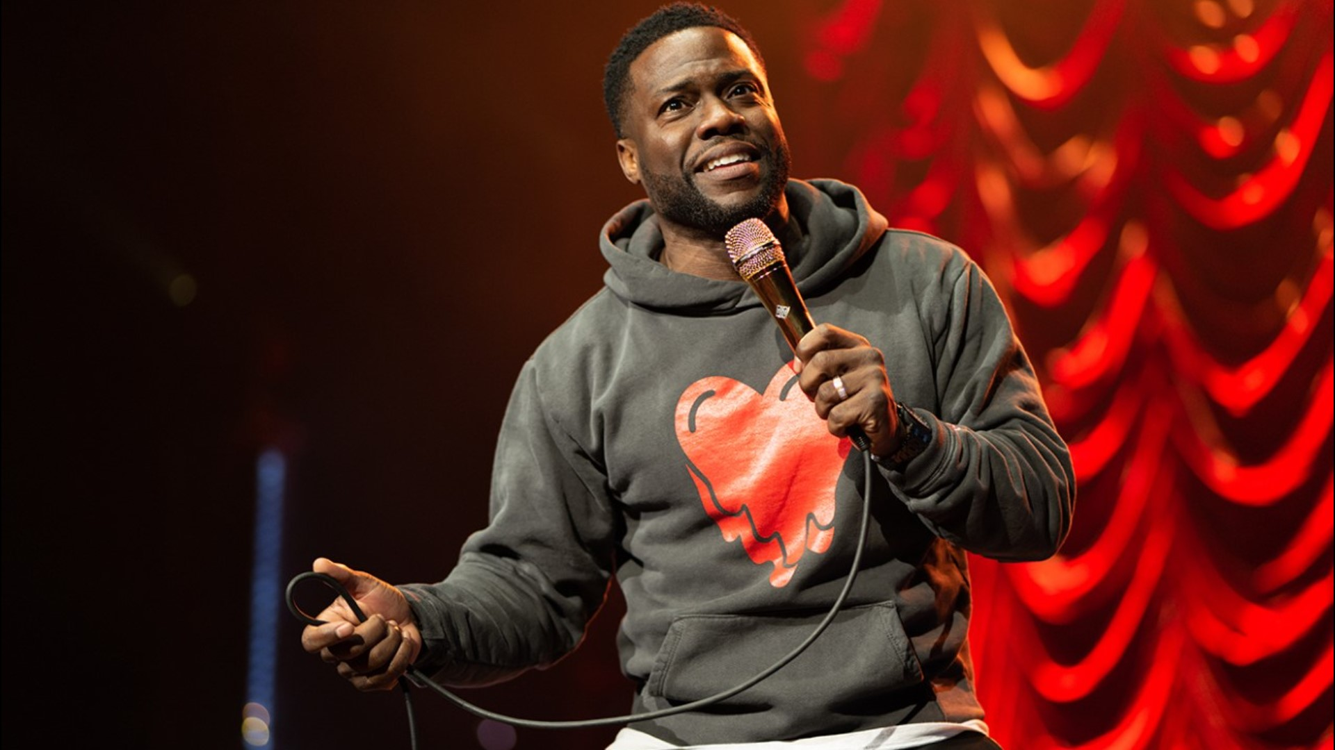

Unique Connection
Why are we here?
Am I?
Selected
Chosen
Required
Representative, varied formality
My relationship with the content, I establish formality
Task oriented, informal

Slide 42
Unique Connection
Raise your hand if…
Published Article
Narrative
Why am I here?
What works?
What works for me?
What are my delivery limitations?
Script
Performance
News Story
Effective* Humor

Slide 43
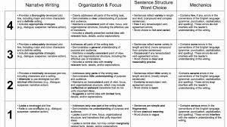
Unique Connection
Misadventures with Officer Stanley Muscle, and that time I got arrested for “Political Terrorism”
Our ship “captain” Steve, proves a point by jumping overboard into the ocean with the sharks
Hilary Clinton’s secret service detail “corrects” me when I politely tell her she’s sitting in my conference chair.
10 minute, 10-million-dollar Power Point presentation
What is filler?
Adding to complete?
Good ideas sometimes don’t fit
“I believe I’m credible on this subject because…”
“Some other prerequisites to consider…”
“Our text defines ___________ as,…”
“I believe a 5th grader would understand ___________”

Slide 44
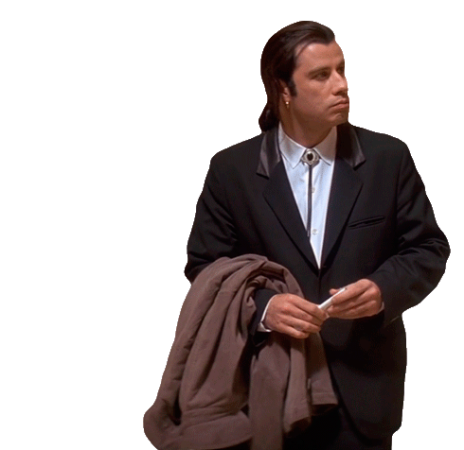
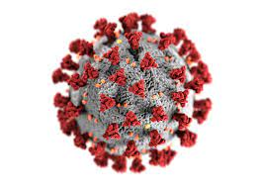


Unique Connection
Example should be visible throughout the presentation*

Slide 45
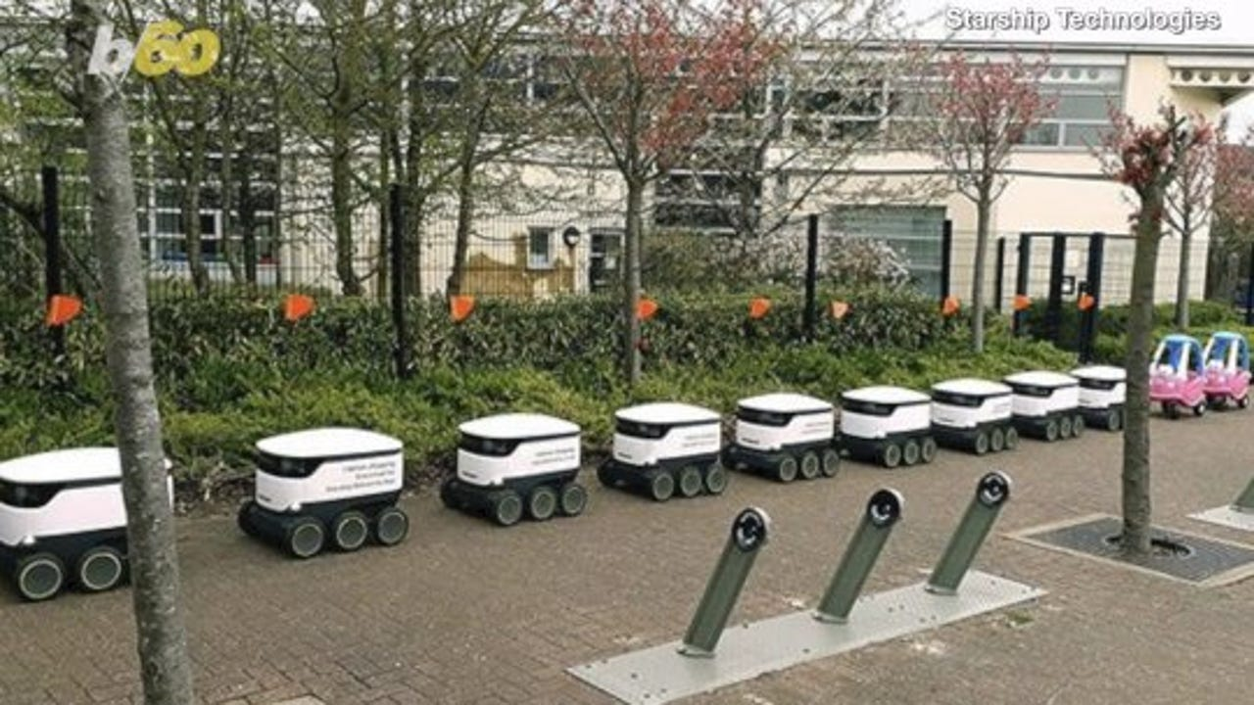
Get to the point yes, I understand the irony
Don’t hide your topic
Intentions should be clear before thesis
Don’t be tedious
Complex body? Shorten the introduction.
Complicated story? Slow it down.
What are the Starship Delivery Robots
How they work
Lastly, we will answer why the robot followed the other Muppets into traffic.
Today we will explore what Machine Learning is
How the Starship Robots use Machine learning
What this means for the future of Purdue

Slide 46
Funnel Content
International soccer. Countries without central water, have national teams. Universal language. MONEY. Winter world cup? America good weather fans?
General to the specific
Specific to thesis
Impactful moment. Outlandish statistics. Introduction of conflict
Today we will look at FIFA, what it is, it’s role in geopolitics and how World Cup hosts are selected.
Name and focus on key topic.
FIFA picks world cup host

Slide 47
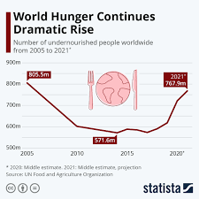
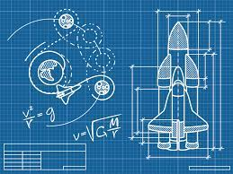
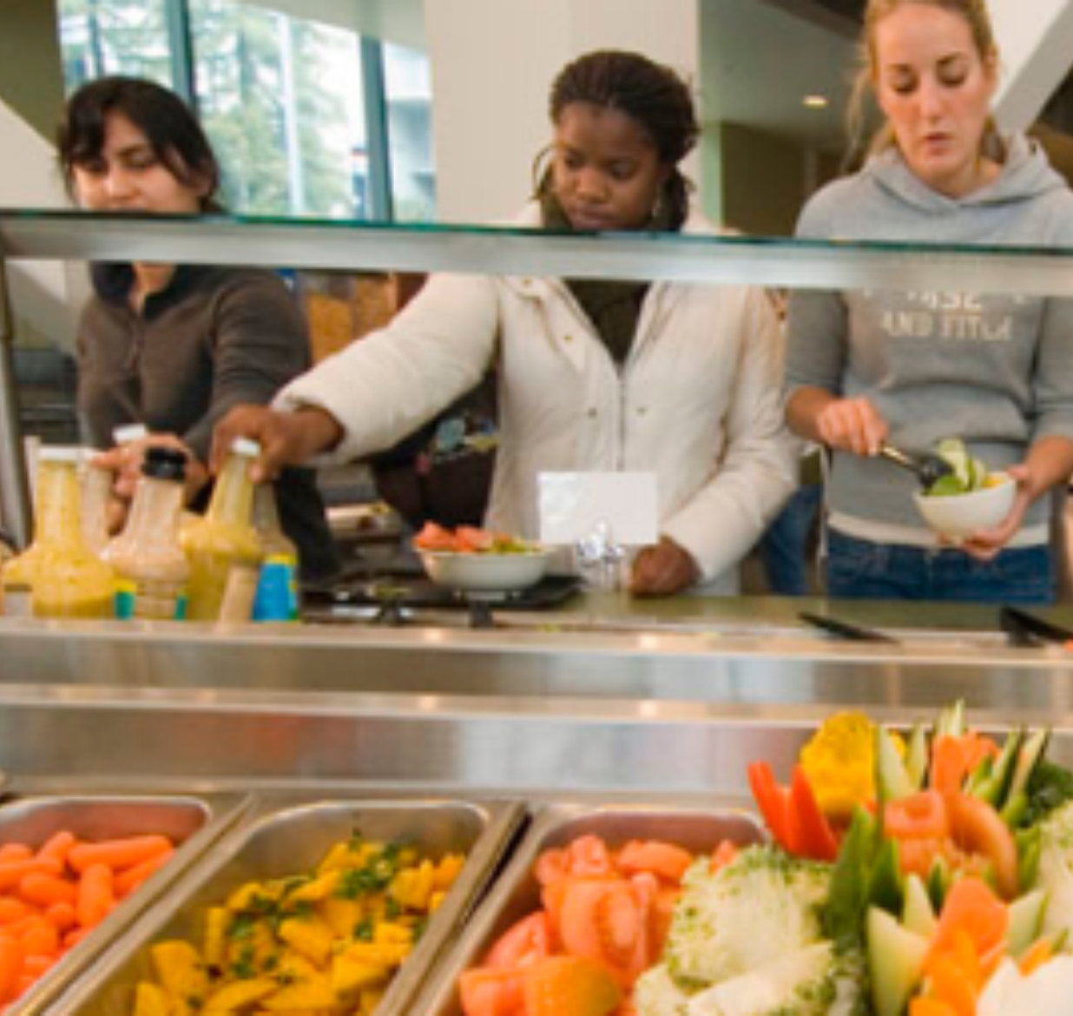

Set the flow
Tell the audience how to act
What should they expect
Don’t switch tone’s
Funny/serious
Conversational/mechanical
Contradictory/Hypocritical

Slide 48
Conclusion I promise
What is the last line of your presentation?
What’s left?
Marking your exit
Bad Habits

Slide 49
What’s left?*
What are your opinions of the subject?
What is the logical next step?
Are all loose ends tied off?

Slide 50
Marking your Exit
Applause should not be confusing***
What is the last line of your speech?
Don’t stammer, don’t be passive
Thank the audience
Attach topic specific qualifier
“Thanks for watching, happy cooking.”
“Thanks for playing along, you all have been a great audience.”

Slide 51
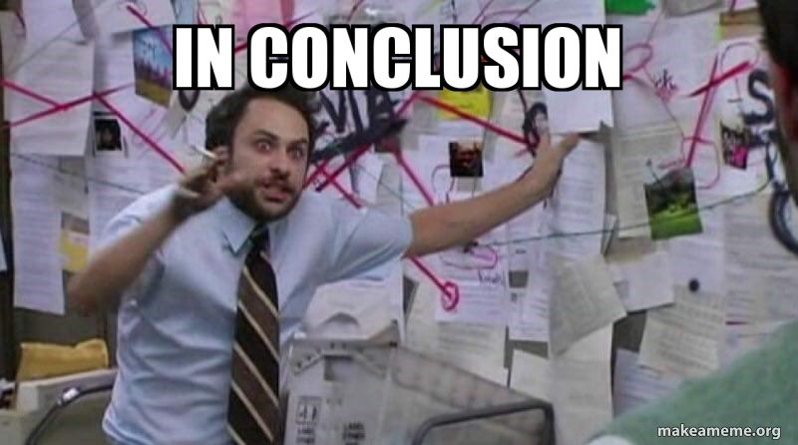
Bad Habits
“In Conclusion”
“I hope”
Late references, New examples
Sprinting to the finish
Too much commentary

